Slide 1
Managing IT should be simpler
@Meraki #CMNA
Hi-Link
Last Update: 12 May 2016
Notes:
Technical Notes:
Before running a Meraki360 session, ensure that you are using the most current version of the deck. Refer to the ”Last Update” datestamp in the bottom left of this slide.
All Meraki presentations are now standardized with the CiscoSans font. Please download and use this font, otherwise the formatting will look odd. Download here: https://drive.google.com/file/d/0B-u6D_JUSBZjdG90RGZZR1Z2eEU/view. Ensure you update the ”COMPANY LOGO HERE” box above with your Distributor logo.

Slide 2
Our mission is to create…
Crafted and robust hardware
Simple and intuitive software
Seamless and powerful integration
Notes:
Cloud management is the best way for us to accomplish our mission, IT should be simpler to monitor and manage
Meraki was built from the ground up for cloud management.
None of our devices have a CLI or local management, all device management from end-to-end (whether it be Aps, swtichtes, FW, phones, or moble devices) are all managed from our easy to use Dashboard, the key that makes the Meraki solution possible.
• Started as Meraki in 2006 with Cloud Managed WiFi
• In 2010, brought the same ease of visibility and management to the wired side of networks
• In 2014, we expanded into Cloud Managed Enterprise, with Systems Manager to manage devices as an extension of the network
• In 2016, we expanded into Cloud Managed IT, including our newest line of products, MC (Meraki Communications) and MV (Meraki Vision)

Slide 3
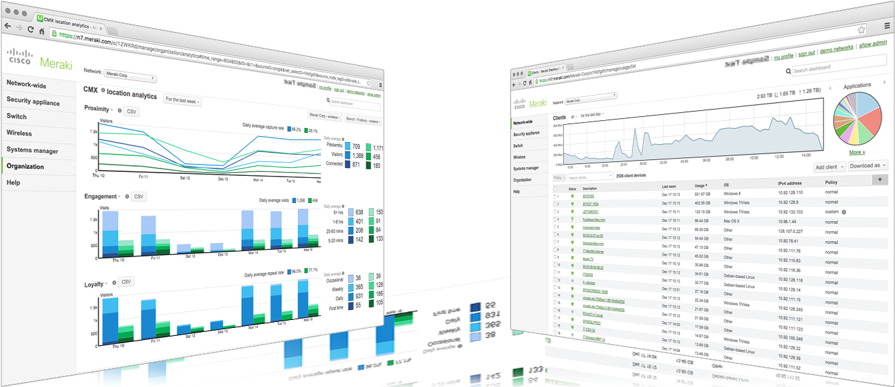
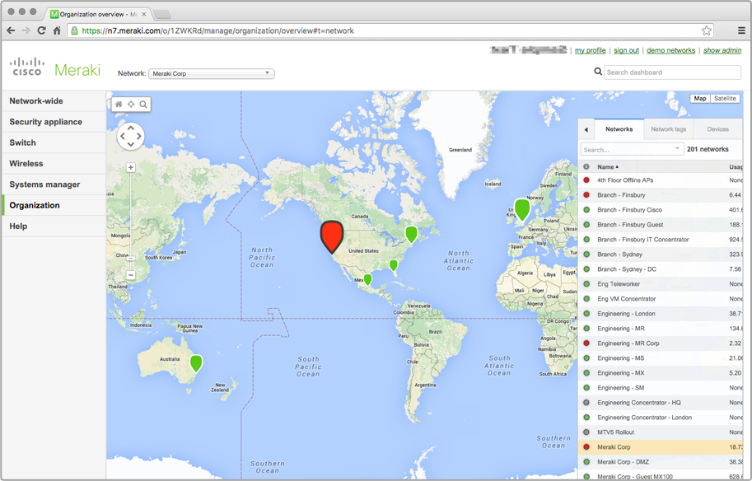
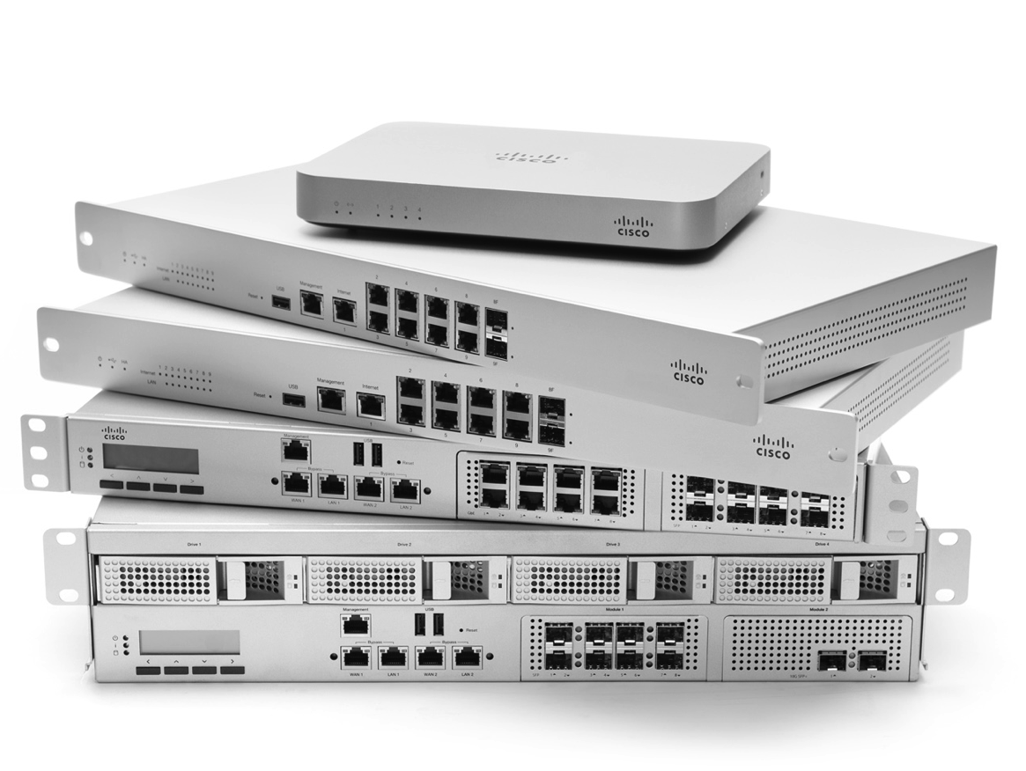
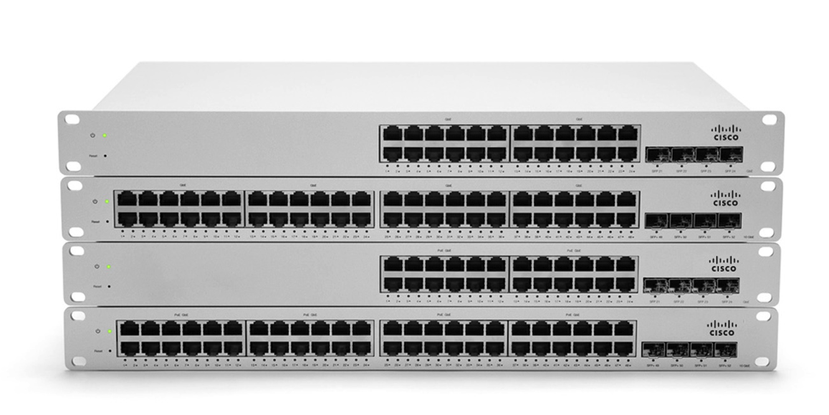
Cisco Meraki: Bringing the cloud to enterprise networks
MR Wireless
MX Security Appliances
MS Switches
SM EMM
MC Communications
MV Vision
CLOUD MANAGED IT
Notes:
Cloud management is the best way for us to accomplish our mission, IT should be simpler to monitor and manage
Meraki was built from the ground up for cloud management.
None of our devices have a CLI or local management, all device management from end-to-end (whether it be Aps, swtichtes, FW, phones, or moble devices) are all managed from our easy to use Dashboard, the key that makes the Meraki solution possible.
• Started as Meraki in 2006 with Cloud Managed WiFi
• In 2010, brought the same ease of visibility and management to the wired side of networks
• In 2014, we expanded into Cloud Managed Enterprise, with Systems Manager to manage devices as an extension of the network
• In 2016, we expanded into Cloud Managed IT, including our newest line of products, MC (Meraki Communications) and MV (Meraki Vision)

Slide 4
How does it work?

Slide 5
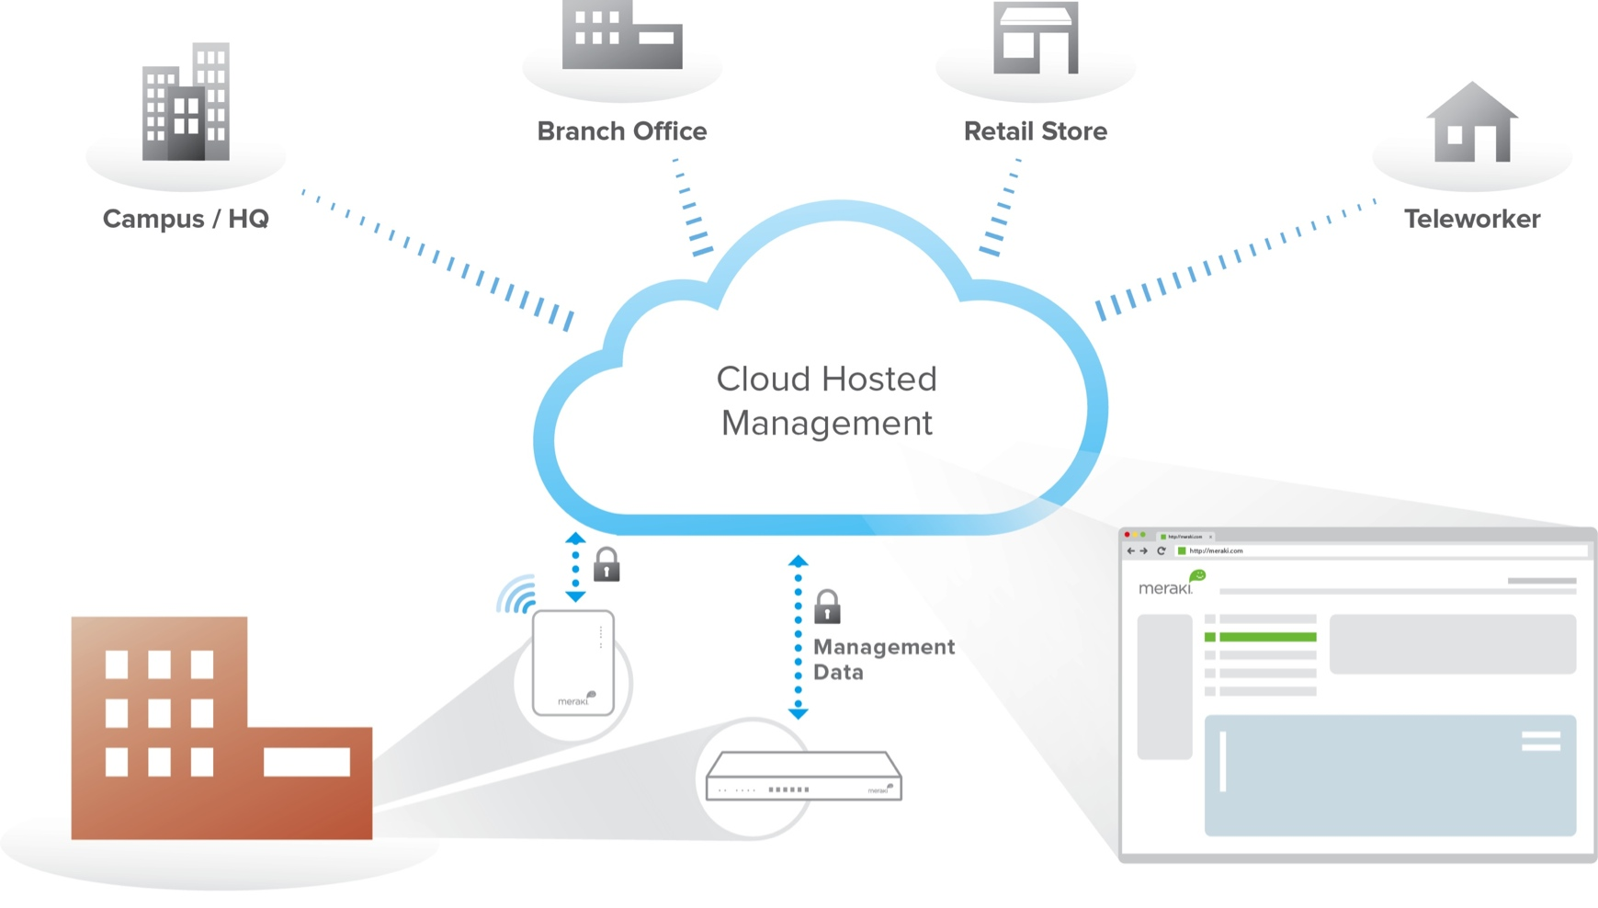
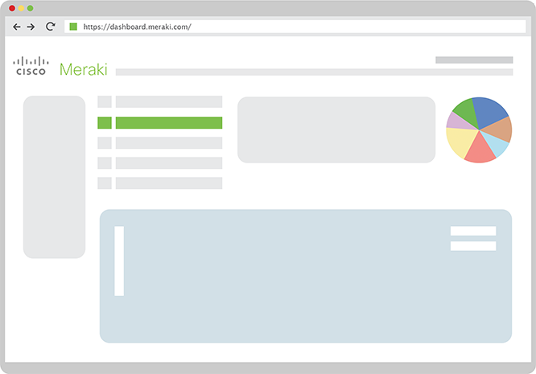
Cloud-managed networking architecture
Network endpoints securely connected to the cloud
Cloud-hosted centralized management platform
Intuitive browser-based dashboard
Notes:
The key to Meraki’s value proposition is the Cloud architecture. When you plug a Meraki device into the internet:
The device establishes a secure tunnel to one of our many datacenters around the globe
The device sends its unique serial number up to the cloud to see if it is registered with a Dashboard account (called an “Organization”)
The device downloads its configuration (any port settings, firewall rules, SSIDs, etc)
The device downloads the latest, greatest version of firmware and reboots. In this way, you know that you are running the latest, greatest version of firmware right out of the box.
Once the device reboots, it will start pushing usage statistics up to the cloud infrastructure. Logging into Dashboard will allow you to immediately see what is happening on the network, even within minutes of plugging in the device.

Slide 6
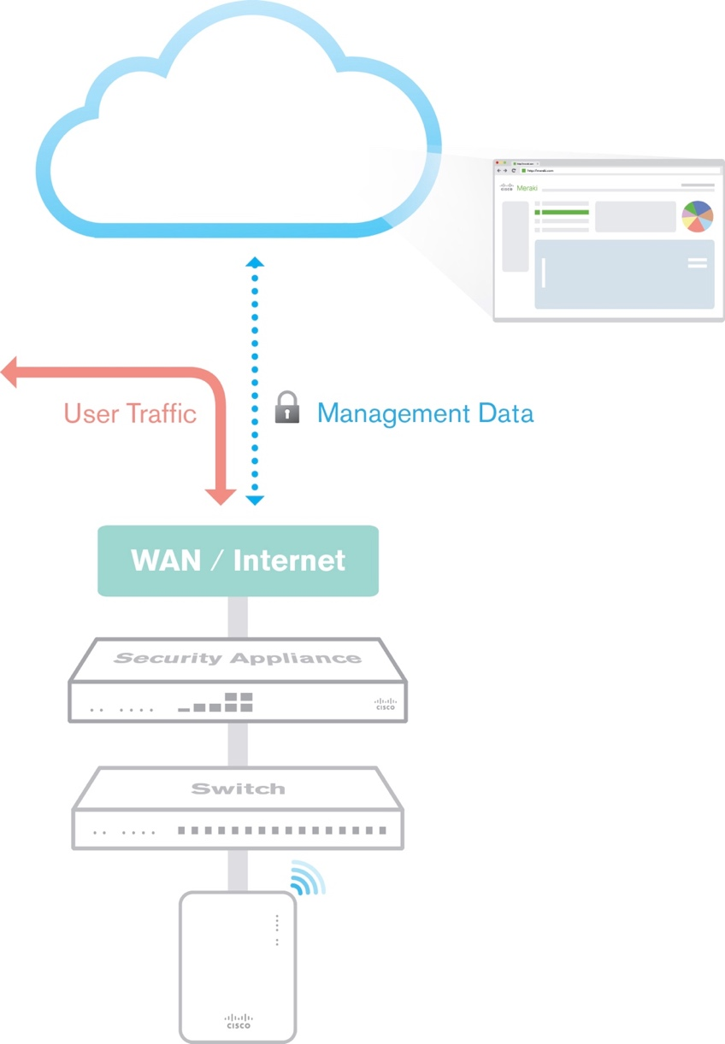
Benefits of a Cloud-based solution
Scalable
Unlimited throughput, no bottlenecks
Add devices or sites in minutes
Reliable
Highly available cloud with multiple datacenters
Network functions even if connection to cloud is interrupted
Secure
No user traffic passes through cloud (out-of-band control plane)
Two-factor authentication and role-based administration
Fully HIPAA / PCI compliant (level 1 certified)
3rd party security audits, daily penetration testing
Reliability and security information at meraki.cisco.com/trust
Future-proof
New features pushed through firmware, guided by customer feedback
Automatic firmware and security updates (user-scheduled)
Notes:
Scalability
The Meraki cloud architecture is highly scalable. It is possible to add hundreds, even thousands of devices to Dashboard simultaneously.
Configuring the devices is very scalable.
Configuration Sync for wireless and security, and Clone for switching allows you to sync settings across devices in a single location, or across geographically dispersed locations easily and with just a few clicks.
Templates allow you to push large-scale changes to many sites or devices simultaneously and with a ”single source of truth,” meaning that if you change an SSID password on the template, it can be updated across the board, essentially eliminating the risk of fat fingering a config change at one of your sites.
Reliability
Meraki operates a highly available cloud architecture with many datacenters around the globe. Furthermore, we are one of the only cloud vendors out there that allows you to specify the geographical area where you would like your data hosted.
Meraki devices do not require cloud connectivity to function. Think of Dashboard as a management and monitoring interface, not a traditional “controller.” Even with an ISP outage or loss of cloud connectivity, the devices will function as configured (all LAN resources will be accessible).
Security
Meraki operates an “out-of-band” control plane, meaning no user traffic passes through the cloud (see diagram to the right). The only data going to the cloud is management data, including usage statistics, configurations changes, and firmware upgrades.
Dashboard and Meraki devices are certified for health care deployments (HIPAA) as well as financial services and credit card transaction processing (PCI DSS v3.1).
Meraki also conducts 3rd party security audits and daily penetration testing on all of our datacenters worldwide. Additionally, all Meraki datacenters are SSAE16 certified.
Refer anyone with additional concerns or questions you cannot answer to meraki.cisco.com/trust to learn more about our security measures.
Future-proof
Uniquely Meraki.
Even as Meraki continues to innovate and bring the newest products to market, we want to make sure that even legacy products are able to take advantage of the newest Meraki features. Therefore, we make sure that all new features are backwards compatible with older products.
This allows your devices to continue to appreciate in value even as they get older. For example, even our older APs support CMX analytics, some of our 1st GEN switches were able to be upgraded from L2 to L3 switches via firmware, and older MXs are able to take advantage of the newest security filtering technologies with AMP and ThreatGrid integration.
Meraki also includes all new firmware and security upgrade with our licensing model. Meraki manages version lists and allows you to schedule when you would like your devices to be upgraded, meaning as an IT admin that you can be confident you are running the latest greatest features and also the most secure builds across all your devices. It also means that IT and the end customer no longer have to manage extensive firmware lists.

Slide 7
The Meraki full stack: a new and unique value proposition
Deploy and grow networks at branch locations or large campuses easily and rapidly
Manage and monitor those networks with robust analytics from a single pane of glass
Reduce administrative overhead with simple all-inclusive licensing models and tools
Notes:
Management and administration are the focal point of this slide, not feature integrations.
Meraki offers a new and unique ”full stack” solution that allows you to manage and monitor your end-to-end network through one easy-to-use web-based interface, Dashboard. Some examples of full stack features you could use as examples:
Organization view: View your entire distributed network “from 30,000 feet” and quickly drill down to identify sites that may be down or malfunctioning
License status tool: Easily manage licensing across large campuses or distributed campuses. Meraki gives you a single end date (through co-termination) that shows you the license time remaining and allows you to renew with one simple transaction.
Network topology: see how your entire network is laid out from a physical perspective, allowing you to see and identify outage or link failures easily
Packet capture: take a live packet capture on any Meraki interface (wired, wireless, VPN, etc) and download it for analysis in Wireshark from anywhere in the work (deep packet analysis from anywhere).

Slide 8
Cisco Meraki MX security appliances
Product Overview

Slide 9
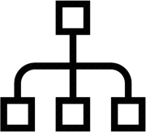
MX security appliances
Feature highlights
Security NG Firewall, Client VPN, Site to Site VPN, IDS/IPS
Networking IWAN, 3G/4G Cellular, Static Routing, Link Balancing
Application Control Traffic Shaping, Content Filtering, Geo Firewall Rules
A complete unified threat management solution
9 models scaling from teleworker and small branch to campus / datacenter

Slide 10
Designed for security and availability
Comprehensive Security
Granular control over phishing, foreign-originated and malicious traffic
Monitor and prevent threats based on severity, specific signatures, and region
Multi-site connectivity
IPSec VPN connections with flexible topology and security policies
Reduce VPN configuration time to seconds and complexity to a few clicks
Redundancy & availability
Increased uptime of mission-critical infrastructure and services
Increase uptime with HA and multi-hub VPN, plus ensure optimal performance with SD-WAN
Notes:
3 key features of MX
Comprehensive security
AMP security allows you to control for IDS/IPS threats as well as malware. L7 firewall rules allow you to keep traffic local to your country or prevent traffic to specific regions
Multi-site connectivity
AutoVPN: Cisco Meraki’s unique auto provisioning site-to-site VPN connects branches securely, without tedious manual VPN configuration. Leveraging the power of the cloud, MX Security Appliances configure, monitor, and maintain your VPN so you don't have to.
Redundancy & availability
HA on MX allows for two MX in a warm spare pair at the head-end of the network or as VPN concentrators behind another firewall.
Multi-hub VPN allows for datacenter-datacenter failover (DC-DC failovere) in the case of a failure event. Therefore, all remote peers will still be able to contact a redundant datacenter.
Intelligent WAN (IWAN)/SD-WAN: Ensure the network to dynamically adjusts to changing WAN conditions, such as latency, jitter and packet loss. IWAN can ensure optimal performance for critical applications and help to avoid disruptions of highly performance-sensitive traffic, such as VoIP.

Slide 11
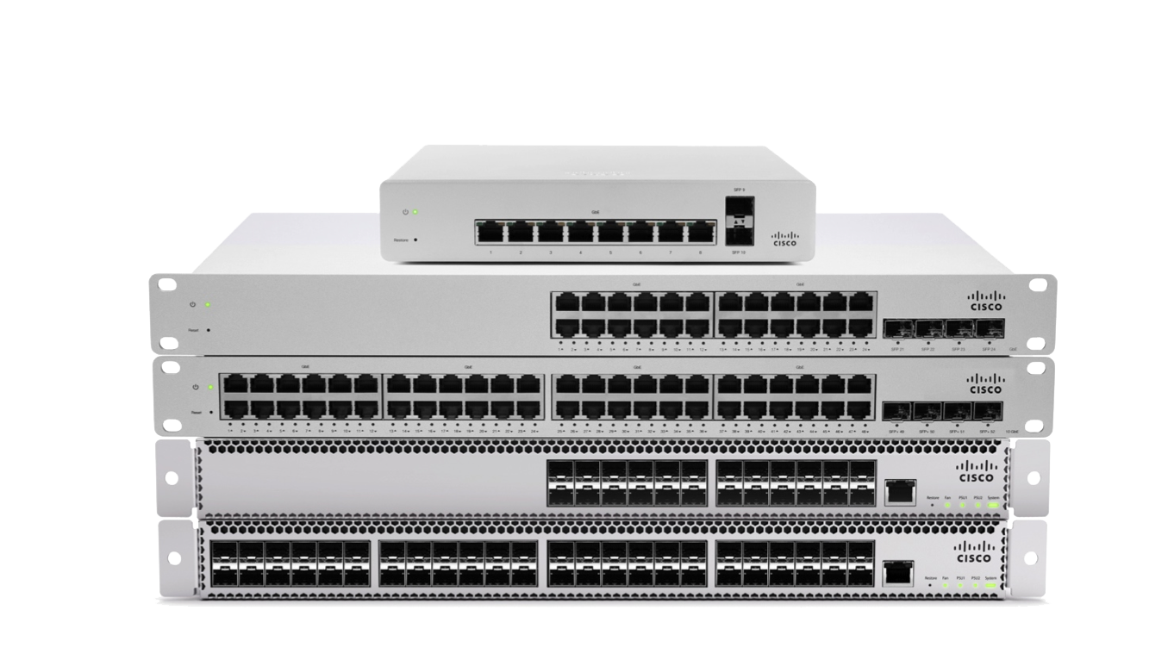
Cisco Meraki MS switches
Product Overview

Slide 12
MS switches
Feature highlights
Voice and video QoS
Layer 7 app visibility
Virtual and physical stacking
Dynamic routing
Enterprise security
Introducing cloud managed physical stacking, multigigabit performance, and UPoE power to the campus network
6 families scaling from access to campus aggregation at Layer 2 or Layer 3

Slide 13
Designed for visibility, intuitive management and speed
Full network visibility
Cable testing, port-cycling, packet capture, and more
View the network with dynamic network topology and troubleshoot with remote diagnostic tools
Scalable management
Stack switches your way: virtually, physically, or both
Manage thousands of ports across geographically dispersed switches with virtual stacking
High-speed analysis
A myriad of standards-based technologies allow you to achieve the speed you need
Push past gigabit speeds with mGig, QSFP+ ultra-high throughput uplinks, and physical stacking. All while recording line-rate L7 application analysis
Notes:
3 key features of MS
Network visibility and troubleshooting
Network topology in Dashboard is dynamically updating (via CDP and LLDP advertisements) and allows you to see exactly how your network is laid out. Topology even allows you to see non-Meraki switches in the network, provided they are advertising LLDP or CDP and are 1 hop away from a Meraki switch.
Dashboard also has a number of tools that make remote troubleshooting easier:
Visualize switch health across your entire switcihing fabric or multi-site deployment
Remote packet capture on any Meraki interface and do remote in-depth packet analysis from anywhere
Remote cable test
Remote port-cycle tool to reboot or reset the connection on APs, VoIP phones, and other endpoint devices.
Scalability in management
Virtual stacking allows IT manager to easily manage multiple switches around a large campus or even around the world. Port tags allow you to group switch ports logically and apply policies (such as a port schedule to save energy) to all of them simultaneously. Additionally, switch templates allow you to manage many different switches with the same configuration just like you would manage a single switch.
Physically stack your switches to implement redundancy and increase inter-switch throughput. Continue to manage your switch stacks with the ease of virtual stacking
High-speed analysis
Meraki switches now come in a large variety of different speeds, ranging from entry level 1Gig / 1Gig SFPs (MS200 series) to switches with 1Gig/2.5Gig/5Gig/10Gig (using mGig) and 10 Gig SFP+ with 40 Gig QSFP+ that can either be used for physical stacking or uplinked to a core Nexus (or similar) core.
With line-rate L7 analysis, you can put a switch in-line upstream of your non-managed switches, and see exactly what is happening across your entire network.

Slide 14
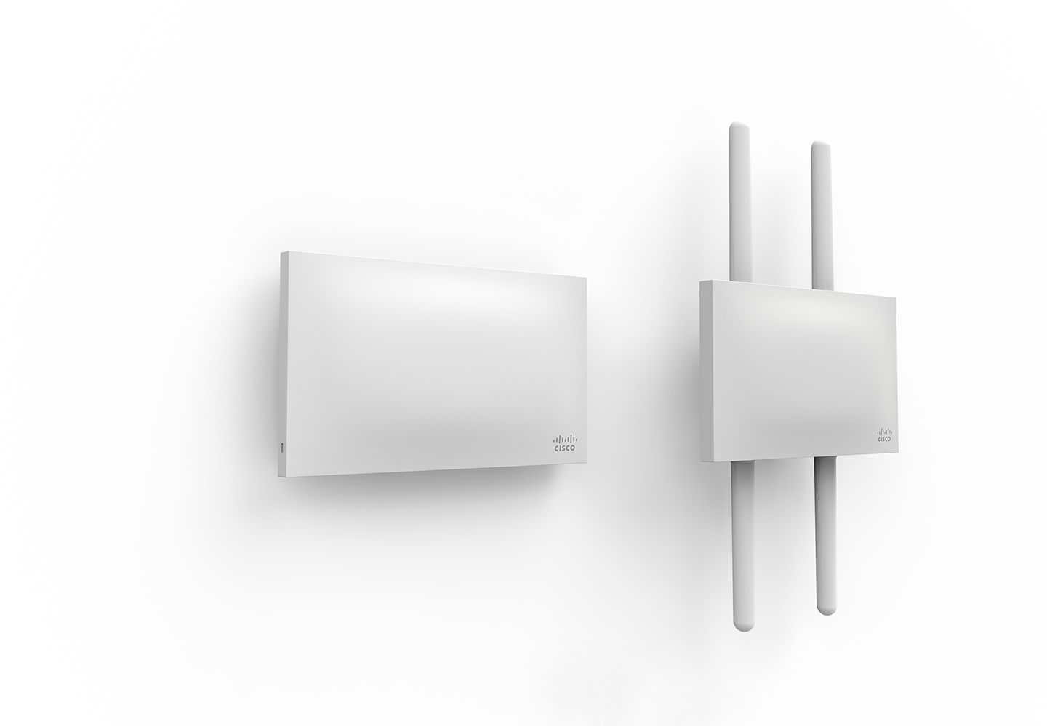
Cisco Meraki MR wireless access points
Product Overview

Slide 15
MR wireless access points
Feature highlights
BYOD policies
Application traffic shaping
Guest access
Enterprise security
WIDS / WIPS
Location analytics
802.11ac Wave 2, multigigabit performance, dedicated scanning and BLE radios
9 models including indoor / outdoor, high performance and value-priced
Notes:
Wireless: the most mature of the Meraki product lines, it is one of the most feature rich

Slide 16
Designed for performance and analytics
Visibility and control
Client and L7 visibility and management
Get insights into network users, devices, and applications for smarter network management
Strategic analytics
BLE Engagement and loyalty tracking across sites
Reach beyond IT to add visibility and value to other parts of the business with CMX Analytics
Security + performance
Enforce full spectrum security while serving clients at 802.11ac
3rd radio detects and mitigates interference, vulnerabilities, and attacks on all channels
Notes:
3 key features of MR
Visibility and control
Just like all Meraki products, Meraki wireless gives you full visibility into what your users are doing on the network. Use this info to create L3 and L7 firewall rules, plus use traffic shaping right on the APs to control how users are consuiming bandwidth on the network. No additional appliances necessary
Strategic analytics
Meraki wireless allows IT to use the network to add value to the organization. No longer does IT simply have to be seen as a cost. CMX analytics provide real information that can be used to make business decisions. For example, lets say you want to test a new advertising campaign. If you run the campaign at Store A but not at Store B, you can see if the campaign drove any additional traffic to Store A. If it there was an uptick, you know that the campaign appears to be successful. Additionally, the CMX analytics API allows business to take data like real MAC address, XY coordinates, time stamp, RSSI, etc and slice and dice it to make data driven decisions for their business.
BLE also allows for additional engagement by integrating with apps on consumer phones. BLE can also be used in conjunction with beacons to track assets as they move about a building (like a warehouse or large department store) or get alerts if a high-value asset leaves the premises.
Security + performance
All Meraki indoor APs and the MR72 outdoor AP have a third dual-band radio that provides the AP with important information and allows it to act on that information.
Air Marshal: Full-time WIPS scanning with the third radio (across all channels on both the 2.4GHz and 5GHz band. If the AP discovers a rogue AP or an SSID spoof, it can automatically mitigate the threat by sending disassociation packets to the AP so that no one is able to connect and be threatened by the rogue.
Auto RF: The third radio is always monitoring for sources of interference on the network and can use this data to intelligently choose power and channel settings across all APs in the network. Additionally, Auto RF can reduce client stickiness and oversubscribed APs.

